Slide 1
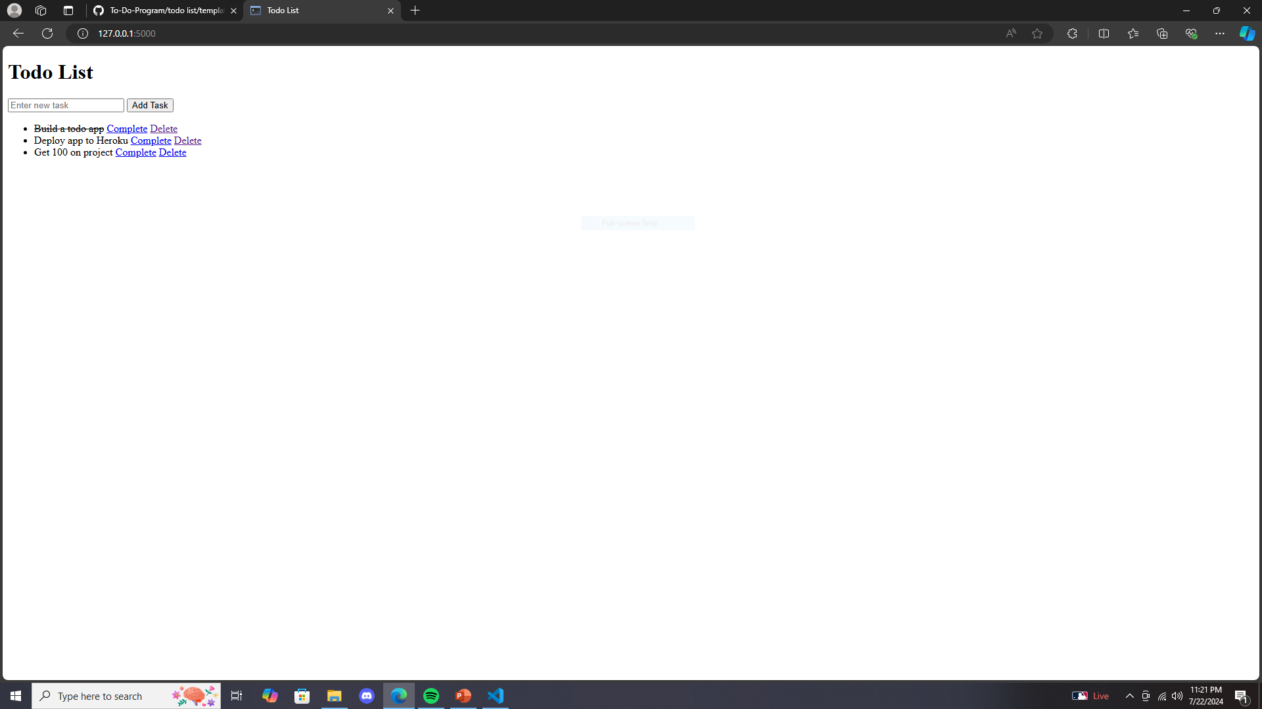
To-do list program
Easily organize, prioritize, and categorize tasks at user preference with the highly intuitive flask based program.
Group Members:
Andrew Warner

